Slide 1

ETHICAL HACKING

Slide 2
OVERVIEW OF HACKING :
HACK :
EXAMINE SOMETHING VERY MINUTELY.
THE RAPID CRAFTING OF NEW PROGRAM OR THE MAKING OF CHANGES TO EXISTING , USUALLY COMPLICATED SOFTWARE .
HACKER :
THE PERSON WHO HACKS .
CRACKER :
SYSTEM INTRUDER OR DESTROYER .

Slide 3
What is ETHICAL HACKING ?
INDEPENDENT COMPUTER SECURITY PROFESSSIONALS BREAKING INTO THE COMPUTER SYSTEM .
NEITHER DAMAGE THE TARGET SYSTEMS NOR STEAL THE INFORMATION.
EVALUATE TARGET SYSTEM SECURITY AND REPORT BACK TO OWNER ABOUT THE VULNERABALITIES FOUND .

Slide 4
TYPES
BLACK HATS
WHITE HATS
GREY HATS
OF
HACKERS

Slide 5
DESCRIPTION about the types of hackers :
PROFESSIONAL HACKERS :
BLACK HATS _____ THE BAD GUYS
WHITE HATS _____PROFESSIONAL SECURITY EXPERTS
SCRIPT KIDDIES :
MOSTLY KIDS /STUDENTS :
Use tools created by black hats ,
- To get free stuff
- Impress their peers
- Not to get caught

Slide 6
UNEMPLOYED ADULT HACKERS :
FORMER SCRIPT KIDDIES
- CAN’T GET EMPLOYMENT IN THE FIELD
- WANT RECOGNITION IN HACKER’S COMMUNITY
- BIG IN EASTERN EUROPEAN COUNTRIES
IDEOLOGICAL HACKERS :
HACK AS A MECHANISM TO PROMOTE SOME POLITICAL AND IDEOLOGICAL PURPOSE
USUALLY CONCIDE WITH POLITICAL EVENTS .

Slide 7
TYPES OF HACKING
LOCAL HACKING
SOCIAL ENGINEERING
REMOTE HACKING

Slide 8
Description :
LOCAL HACKING
LOCAL HACKING IS DONE FROM LOCAL AREA WHERE WE HAVE PHYSICAL ACCESS LIKE THROUGH PRINTER ETC .
REMOTE HACKING
:
REMOTE HACKING IS DONE REMOTELY BY TAKING ADVENTAGE OF THE VULNERABALITY OF THE TARGET SYSTEM .
SOCIAL ENGINEERING
:
SOCIAL ENGINEERING IS THE ACT OF MANIPULATING PEOPLE INTO PERFORMING ACTIONS OR DIVULGING CONFIDENTIAL INFORMATION .
WE CAN DO THIS TYPE OF HACKING THROUGH TROJAN AND VIRUSES WITH THE HELP OF HARD DISK AND PENDRIVE.
IN MOST CASES THE ATTACKER NEVER COMES FACE TO FACE .

Slide 9

ETHICAL HACKERS ARE NOT CRIMINAL HACKERS

Slide 10

BUT HOW ????

Slide 11

COMPLETELY TRUSTWORTHY
STRONG PROGRAMMING AND COMPUTER NETWORKING SKILLS
LEARN ABOUT THE SYSTEM AND TRYING TO FIND ITS WEEKNESSES
TECHNIQUES OF CRIMINAL- HACKERS – DETECTION – PREVENTION
NO EX- HACKERS
PUBLISH RESEARCH PAPERS AND RELEASED SECURITY

Slide 12
DIFFERENCE B/W
HACKER
ETHICAL HACKER
ACCESS COMPUTER SYSTEM OR NETWORK WITHOUT AUTHORIZATION AND BREAKS THE LAW
PERFORM MOST OF THE SAME ACTIVITIES BUT WITH THE OWNER’S PERMISSION AND EMPLOYED BY COMPANIES TO PERFORM PENETRATION TESTS .

Slide 13

MODES OF ETHICAL HACKING
INSIDER ATTACK
OUTSIDER ATTACK
STOLEN EQUIPMENT ATTACK
PHYSICAL ENTRY
SOCIAL ENGINEERING ATTACK

Slide 14

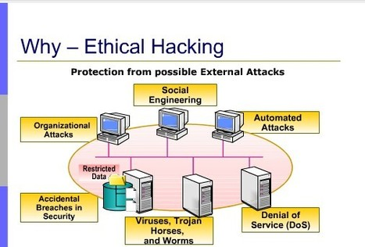

Slide 15
THE ETHICAL HACKING PROCESS

Slide 16
Ethical hackers must follow a strict scientific process in order to obtain useable and legal results
Planning
Reconnaissance
Enumeration
Vulnerability Analysis
Exploitation
Deliverables

Slide 17
1- PLANNING :
Planning is essential for having a successful project. It provides an opportunity to give critical thought to what needs to be done, allows for goals to be set, and allows for a risk assessment to evaluate how a project should be carried out.
There are a large number of external factors that need to be considered when planning to carry out an ethical hack. These factors include existing security policies , culture, laws and regulations, best practices, and industry requirements. Each of these factors play an integral role in the decision making process when it comes to ethical hacking. The planning phase of an ethical hack will have a profound influence on how the hack is performed and the information shared and collected, and will directly influence the deliverable and integration of the results into the security program.
The planning phase will describe many of the details of a controlled attack. It will attempt to answer questions regarding how the attack is going to be supported and controlled, what the underlying actions that must be performed and who does what, when, where, and for how long.

Slide 18
2- Reconnaissance
Reconnaissance is the search for available information or resources to assist in an attack. This can be as simple as a ping or browsing newsgroups on the Internet in search of disgruntled employees divulging secret information or as messy as digging through the trash to find receipts or letters.
Reconnaissance can include social engineering, tapping phones and networks, or even theft. The search for information is limited only by the extremes at which the organization and ethical hacker are willing to go in order to recover the information they are searching for.
The reconnaissance phase introduces the relationship between the tasks that must be completed and the methods that will need to be used in order to protect the organization's assets and information.

Slide 19
3- Enumeration
Enumeration is also known as network or vulnerability discovery. It is the act of obtaining information that is readily available from the target's system, applications and networks. It is important to note that the enumeration phase is often the point where the line between an ethical hack and a malicious attack can become blurred as it is often easy to go outside of the boundaries outlined in the original attack plan.
In order to construct a picture of an organization's environment, several tools and techniques are available. These tools and techniques include port scanning and NMap . Although it is rather simple to collect information, it is rather difficult to determine the value of the information in the hands of a hacker.
At first glance, enumeration is simple: take the collected data and evaluate it collectively to establish a plan for more reconnaissance or building a matrix for the vulnerability analysis phase. However, the enumeration phase is where the ethical hacker's ability to make logical deductions plays an enormous role.

Slide 20
4- Vulnerability Analysis
In order to effectively analyze data, an ethical hacker must employ a logical and pragmatic approach. In the vulnerability analysis phase, the collected information is compared with known vulnerabilities in a practical process.
Information is useful no matter what the source. Any little bit can help in discovering options for exploitation and may possibly lead to discoveries that may not have been found otherwise. Known vulnerabilities, incidents, service packs, updates, and even available hacker tools help in identifying a point of attack. The Internet provides a vast amount of information that can easily be associated with the architecture and strong and weak points of a system

Slide 21
5-Exploitation
A significant amount of time is spent planning and evaluated an ethical hack. Of course, all this planning must eventually lead to some form of attack. The exploitation of a system can be as easy as running a small tool or as intricate as a series of complex steps that must be executed in a particular way in order to gain access.
The exploitation process is broken down into a set of subtasks which can be many steps or a single step in performing the attack. As each step is performed, an evaluation takes place to ensure that the expected outcome is being met. Any divergence from the attack plan is classified into two determinations:
Expectations: Are the expectations of the exploitation being met or are the results conflicting with the organization's assumptions?
Technical: Is the system reacting in an unexpected manner, which is having an impact on the exploitation and the engagement as a whole?

Slide 22
6- Deliverables
Deliverables communicate the results of tests in numerous ways. Some deliverables are short and concise, only providing a list of vulnerabilities and how to fix them, while others are long and detailed, providing a list of vulnerabilities with detailed descriptions regarding how they were found, how to exploit them, the implications of having such a vulnerability and how to remedy the situation.
The deliverable phase is a way for an ethical hacker to convey the results of their tests. Recently, ethical hacking has become so commoditized that if a deliverable does not instill fear into the hearts of executives, it could be considered a failure

Slide 23

ETHICAL HACKING SKILLS AND KNOWLEDGE

Slide 24
Required skills
An ethical hacker is required to possess a vast arrangement of computer skills. It is not feasible for each ethical hacker to be an expert is every field and thus ethical hacking tiger teams whose members have complementing skills are created to provide an organization with a team possessing the complete skill set required of an ethical hacker.
Organizations may have a wide variety of computer systems and it is essential for any ethical hacker to have expertise in operating systems , as well as network hardware platforms. It is also fundamental that an ethical hacker posses a solid foundation of the principles of information security .

Slide 25

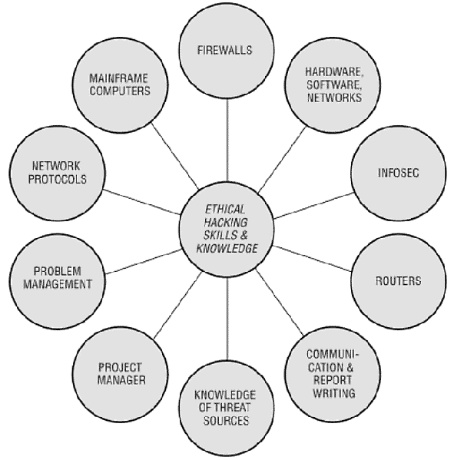

Slide 26

Salaries and Trends

Slide 27
A survey done by the International Data Corp (IDC) says that the worldwide demand for information security professionals stands at 60,000 and companies such as Wipro, Infosys, IBM, Airtel and Reliance are always looking for good ethical hackers

Slide 28
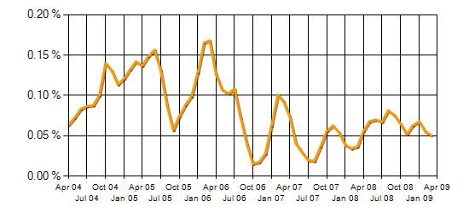
In the United Kingdom, the following trends have been seen for demand and salaries of ethical hackers.

Slide 29
Although there are benefits to teaching and employing ethical hacking techniques, there are problems that lead some to question the practice. It is feared that schools may be teaching dangerous skills to students that are unable to make correct decisions on how to use them.

Slide 30
Marcus J. Ranum, a computer security professional has openly objected to the term ethical hacker, saying "There's no such thing as an 'ethical hacker' - that's like saying 'ethical rapist' - it's a contradiction in terms" ^{[9]}. A significant part of the controversy surrounding ethical hacking arises from the older definition of hacker and its association with the idea of a computer criminal. However, some organizations do not seem to mind the association and have had a significant increase in careers where CEH and other ethical hacking certifications are preferred or required.

Slide 31
1. Ethical Issues
One of the concerns about teaching ethical hacking is that the wrong people may be taught very dangerous skills. Hacking skills were traditionally acquired by many hours of practice or intense tutoring from another hacker. University programs and commercial training classes are now offering a new way for aspiring hackers to learn how to penetrate systems. Teaching students how to attack systems without providing ethical training may be teaching criminals and terrorists how to pursue their illegal activities. Some individuals have compared teaching ethical hacking to undergraduate students to handing them a loaded gun.

Slide 32
2. Legal Liability
Adding ethical hacking to a curriculum raises a variety of legal issues where schools and faculty members may be held responsible for the actions of their students. The use of many hacking tools outside of an isolated test network may be illegal. By allowing unmonitored hacking sessions, the school or faculty member may be allowing a breach of the law or violation of software licensing agreements.
In a case of The United States versus Morris, a judge determined that the Computer Fraud and Misuse Act (18 USC 1030) applies to educational institutions and that an individual is liable for the accidental release of malware . The schools that facilitated the creation of malware would be liable for damages from malware released from their labs.

Slide 33
Forcing Services and Information on Organizations and Society
Sometimes ethical hackers operate without the permission or knowledge of the owners of a system. The rationale given for this is that they are only testing security and do not intend to cause damage or compromise any individual’s privacy.
However, ethical hackers may be able to uncover information about Web sites and applications that the owners of these sites and applications do not want uncovered. The situation is compared to finding a note on your refrigerator informing you that "I was testing the security of back doors in the neighborhood and found yours unlocked. I just looked around. I didn't take anything. You should fix your lock." This situation is what leads to the necessity for a proper test plan and strict guidelines for following it.

Slide 34

FUTURE SCOPE OF ETHICAL HACKING

Slide 35
AS IT IS AN INVOLVING BRANCH ,THE SCOPE OF ENHANCEMENT IN TECHNOLOGY IS IMMENSE . NO ETHICAL HACKER CAN ENSURE THE SYSTEM SECURITY BY USING THE SAME TECHNIQUES REPEATEDLY . HOW WOULD HAVE TO IMPROVE , DEVELOP AND EXPLORE NEW AVENUES REPEATEDLY. MORE ENHANCED SOFTWARE’S SHOULD BE USED FOR OPTIMUM PROTECTION . TOOLS USED, NEED TO BE UPDATED REGULARLY AND MORE EFFICIENT ONES NEED TO BE DEVELOPED

Slide 36
References
Twincling Society Ethical Hacking Seminar 2006. Retrieved March 27, 2009.
Krutz, Ronald L. and Vines, Russell Dean. The CEH Prep Guide: The Comprehensive Guide to Certified Ethical Hacking .Published by John Wiley and Sons, 2007.
Palmer, Charles. Ethical Hacking Published in IBM Systems Journal: End-to-End Security, Volume 40, Issue 3, 2001.
Tiller, James S. The ethical hack: a framework for business value penetration testing Published by CRC Press, 2005.
Beaver, Kevin and McClure, Stuart. Hacking For Dummies Published by For Dummies, 2006.
Certified Ethical Hacking Seminar 2006. Retrieved March 27, 2009.
Certified Ethical Hacking EC-Council 2009. Retrieved March 27, 2009.
Certified Ethical Hacking EC-Council 2009. Retrieved March 27, 2009.
Ethical Hacking Jobs 2009. Retrieved March 27, 2009.
D'Ottavi, Alberto. Interview: Father of the Firewall 2003. Retrieved March 27, 2009.
Livermore, Jeffery. What Are Faculty Attitudes Toward Teaching Ethical Hacking and Penetration Testing? Published in Proceedings of the 11th Colloquium for Information Systems Security Education, 2007

Slide 37


